Slide 1
KHATIR DARI KHAATE RAHO, MANGATE RaHO
Student Name: Manvi Lohia, Yashvi Mehta, Janki Kanakia
Roll No: C056,C060,C046
Faculty Mentor: Prof. Krishna Samdani

Slide 2
Outline
Motivation
Introduction
Tools & Techniques
Simulation & Results
Conclusion
Future Work
Reference

Slide 3
Motivation
Had to switch between different tabs to compare prices and offers of different delivery websites
Doing so was wasting valuable time and resources
Thus, this software, saves time by accumulating all data and displaying it at one place

Slide 4
Introduction
Gives user one platform to compare prices and delivery times of multiple food delivery sites for the same restaurant and dishes.
Helps user make the most price or time efficient choice without having to constantly switch between websites and manually compare the same.

Slide 5
Tools & Techniques
We have used CODE::BLOCKS and online compilers.
We provide functionalities like:
login/register,
choose between different restaurants and place order from multiple delivery sites,
choose between payment modes and options,
donate to the society,
rate our services and provide feedbacks for improvements
Techniques used:
inheritance
file handling
Loops and switch cases
if else statements
functions
classes

Slide 6
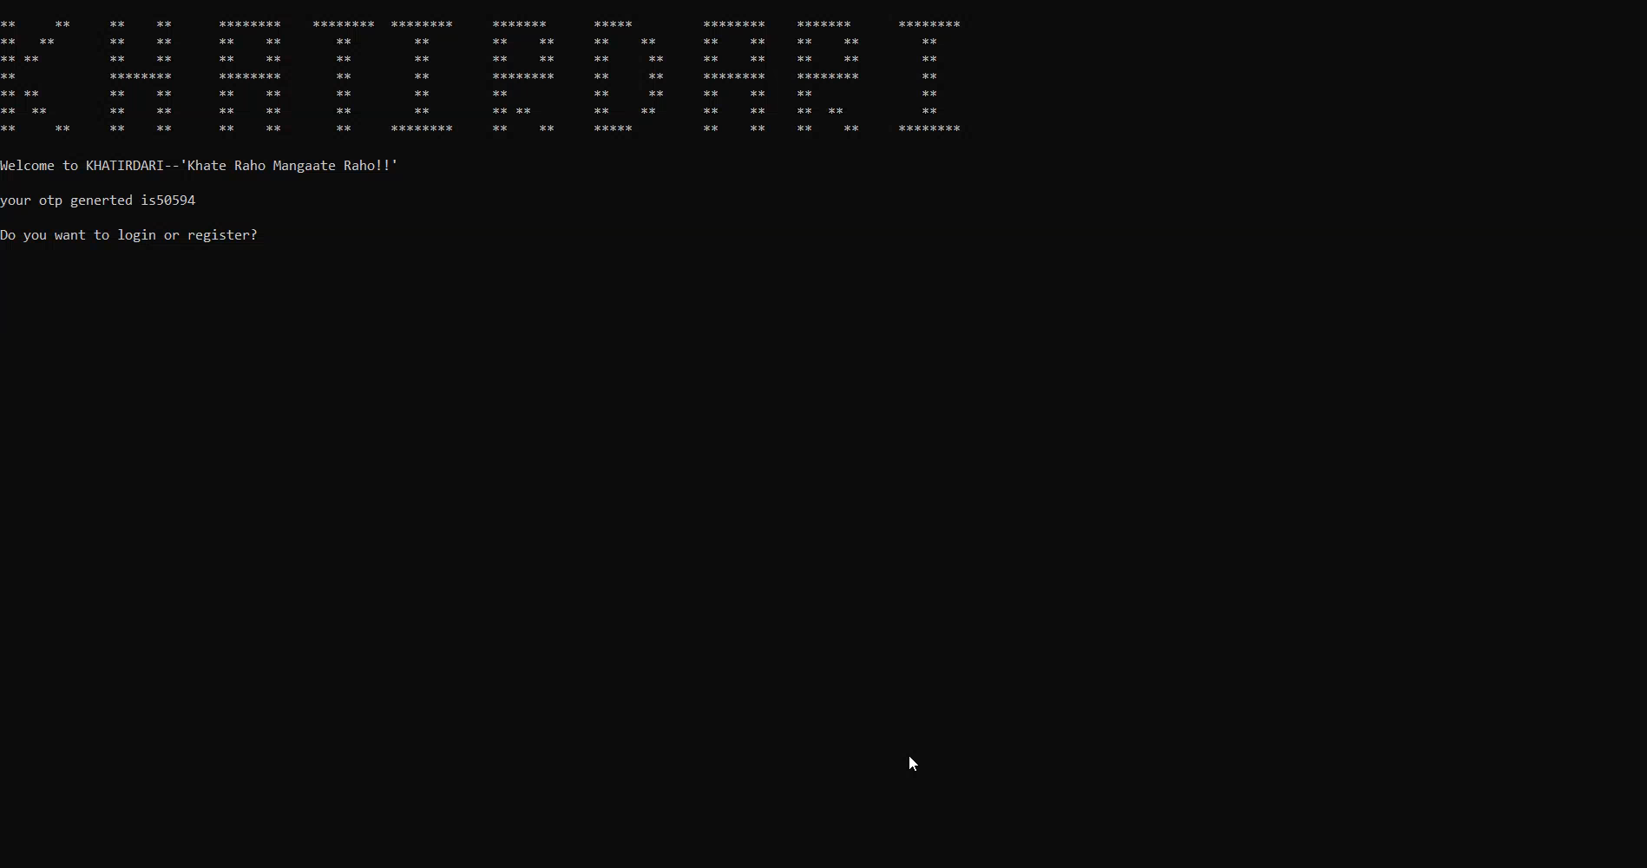
Simulation & Results

Slide 7
Conclusion
The primary focus of ours and this app was to brainstorm and bring revolution in the field of food ordering but providing a platform like never seen before. We tackled each boulder in our way by working together and getting as many as possible different ways to handle the situation. In doing so we made sure that the most effective, user friendly and a smooth program flow was delivered to the user, free of any errors or limitations.

Slide 8
Future Work
collaborating with fast food chains and restaurants directly to help user order directly from the restaurant instead of via another delivery platform.
Introducing more delivery platforms to improve comparison variety.
Introducing additional criterias such as delivery reviews, restaurant reviews etc. to improve quality of comparison and thus choice of decision.
Introducing super membership with perks like restaurant table booking at discounted rates etc.

Slide 9
Reference
Textbook references: Object Oriented Programming with E. Balagurusamy.
Possible functionalities and program flow reference from trivago.
Other sources were as follows
a. https://www.geeksforgeeks.org/c-plus-plus/
b. https://www.tutorialspoint.com/cplusplus/index.htm
c. https://www.onlinegdb.com/online_c++_compiler

